Slide 1
Designing HCI Experiments

Slide 2
Introduction
Learning to conduct and design an experiment is a skill required of all researchers in HCI
Experiment design is the process of deciding what variables to use, what tasks and procedures to use, how many participants to use and how to solicit them, and so on

Slide 3
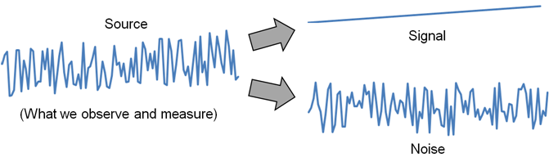
Signal and Noise Metaphor
Signal and noise metaphor for experiment design:
Signal → a variable of interest
Noise → everything else (random influences)
Experiment design seeks to enhance the signal, while minimizing the noise

Slide 4
Methodology
Methodology is the way an experiment is designed and carried out
Methodology is critical:
What methodology?
Don’t just make it up because it seems reasonable
Follow standards for experiments with human participants (next slide)
Science is method. Everything else is commentary.¹
¹ This quote from Allen Newell was cited and elaborated on by Stuart Card in an invited talk at the ACM’s SIGCHI conference in Austin, Texas (May 10, 2012).

Slide 5

APA
American Psychological Society (APA) is the pre-dominant organization promoting research in psychology – the improvement of research methods and conditions and the application of research findings (http://www.apa.org/)
Publication Manual of the APA¹,
first published in 1929, teaches
about the writing process and,
implicitly, about the methodology
for experiments with human
participants
Recommended by major journals
in HCI
¹ APA. (2010). Publication manual of the American Psychological Association (6th ed.). Washington, DC: APA.

Slide 6
Ethics Approval
Ethics approval is a crucial step that precedes every HCI experiment
HCI experiments involve humans, thus…
Proposal submitted to ethics review committee
Criteria for approval: (see HCI:ERP for more detail)
  research methodology
  risks or benefits
  the right not to participate, to terminate participation, etc.
  the right to anonymity and confidentiality
Researchers must respect the safety, welfare, and dignity of human participants in their research and treat them equally and fairly.¹
¹ http://www.yorku.ca/research/students/index.html

Slide 7
Getting Started With Experiment Design
Transitioning from the creative work in formulating and prototyping ideas to experimental research is a challenge
Begin with…
Remember research questions:
Properly formed research questions inherently identify experimental variables (can you spot the independent variable and the dependent variable in the question above?)
What are the experimental variables?
  Can a task be performed more quickly with my new interface than with an existing interface?

Slide 8
Independent Variable
An independent variable (IV) is a circumstance or characteristic that is manipulated in an experiment to elicit a change in a human response while interacting with a computer.
“Independent” because it is independent of participant behavior (i.e., there is nothing a participant can do to influence an independent variable)
Examples:
  interface, device, feedback mode, button layout, visual layout, age, gender, background noise, expertise, etc.
The terms independent variable and factor are synonymous
Notes:
CHI 2012 Course Notes

Slide 9
Test Conditions
An independent variable (IV) must have at least two levels
The levels, values, or settings for an IV are the test conditions
Name both the factor (IV) and its levels (test conditions):
Factor (IV) Levels (test conditions )
Device mouse, trackball, joystick
Feedback mode audio, tactile, none
Task pointing, dragging
Visualization 2D, 3D, animated
Search interface Google, custom
Notes:
CHI 2012 Course Notes

Slide 10
Human Characteristics
Human characteristics are naturally occurring attributes
Examples:
  Gender, age, height, weight, handedness, grip strength, finger width, visual acuity, personality trait, political viewpoint, first language, shoe size, etc.
They are legitimate independent variables, but they cannot be “manipulated” in the usual sense
Causal relationships are difficult to obtain due to unavoidable confounding variables

Slide 11
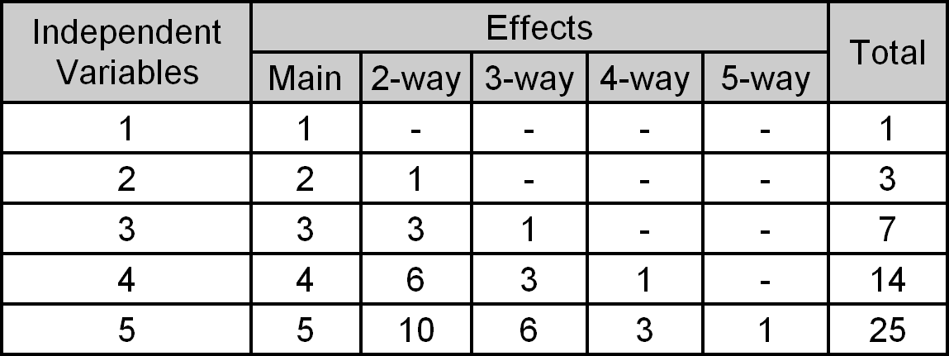
How Many IVs?
An experiment must have at least one independent variable
Possible to have 2, 3, or more IVs
But the number of “effects” increases rapidly with the size of the experiment:
Advice: Keep it simple (1 or 2 IVs, 3 at the most)

Slide 12
Dependent Variable
A dependent variable is a measured human behaviour (related to an aspect of the interaction involving an independent variable)
“Dependent” because it depends on what the participant does
Examples:
  task completion time, speed, accuracy, error rate, throughput, target re-entries, task retries, presses of backspace, etc.
Dependent variables must be clearly defined
  Research must be reproducible!
Notes:
CHI 2012 Course Notes

Slide 13
Unique DVs
Any observable, measurable behaviour is a legitimate dependent variable (provided it has the potential to reveal differences among the test conditions)
So, feel free to “roll your own”
Example: negative facial expressions¹
  Application: user difficulty with mobile games
  Events logged included frowns, head shaking
  Counts used in ANOVA, etc.
  Clearly defined → reproducible
¹ Duh, H. B.-L., Chen, V. H. H., & Tan, C. B. (2008). Playing different games on different phones: An empirical study on mobile gaming. Proceedings of MobileHCI 2008, 391-394, New York: ACM.

Slide 14
Data Collection
Obviously, the data for dependent variables must be collected in some manner
Ideally, engage the experiment software to log timestamps, key presses, button clicks, etc.
Planning and pilot testing important
Ensure conditions are identified, either in the filenames or in the data columns
Examples: (next two slides)

Slide 15
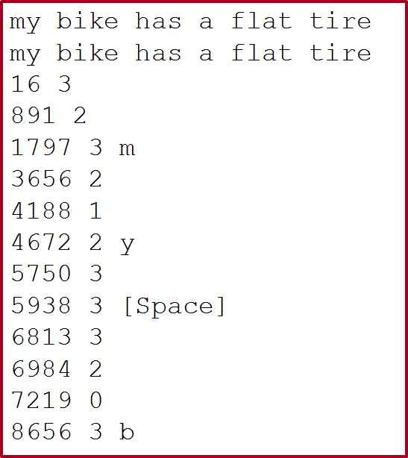
TextInputHuffman-P01-D99-B06-S01.sd1

Slide 16
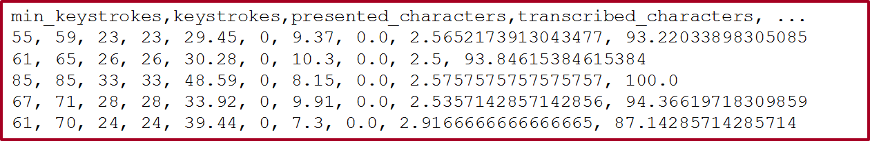
TextInputHuffman-P01-D99-B06-S01.sd2

Slide 17
Control Variable
A control variable is a circumstance (not under investigation) that is kept constant while testing the effect of an independent variable
More control means the experiment is less generalizable (i.e., less applicable to other people and other situations)
Research question: Is there an effect of font color or background color on reading comprehension?
  Independent variables: font color, background color
  Dependent variable: comprehension test scores
  Control variables
    Font size (e.g., 12 point)
    Font family (e.g., Times)
    Ambient lighting (e.g., fluorescent, fixed intensity)
    Etc.
Notes:
CHI 2012 Course Notes

Slide 18
Random Variable
A random variable is a circumstance that is allowed to vary randomly
More variability is introduced in the measures (that’s bad!), but the results are more generalizable (that’s good!)
Research question: Does user stance affect performance while playing Guitar Hero?
  Independent variable: stance (standing, sitting)
  Dependent variable: score on songs
  Random variables
    Prior experience playing a real musical instrument
    Prior experience playing Guitar Hero
    Amount of coffee consumed prior to testing
    Etc.
Notes:
CHI 2012 Course Notes

Slide 19
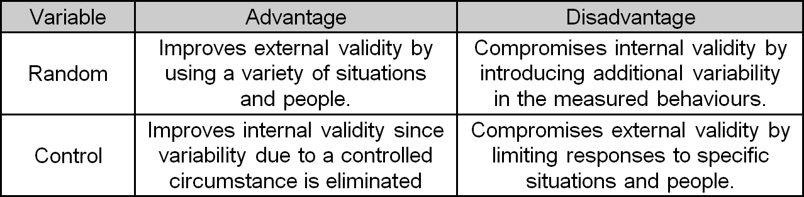
Control vs. Random Variables
There is a trade-off which can be examined in terms of internal validity and external validity (see below)

Slide 20
Confounding Variable
A confounding variable is a circumstance that varies systematically with an independent variable
Should be considered, lest the results are misleading
Research question: In an eye tracking application, is there an effect of “camera distance” on task completion time?
  Independent variable: Camera distance (near, far)
    Near camera (A): inexpensive camera mounted on eye glasses
    Far camera (B): expensive camera mounted above system display
  Dependent variable: task completion time
  But, “camera” is a confounding variable: camera A for the near setup, camera B for the far setup
  Are the effects due to camera distance or to some aspect of the different setups?
  (see HCI:ERP for the solution)
Notes:
CHI 2012 Course Notes

Slide 21
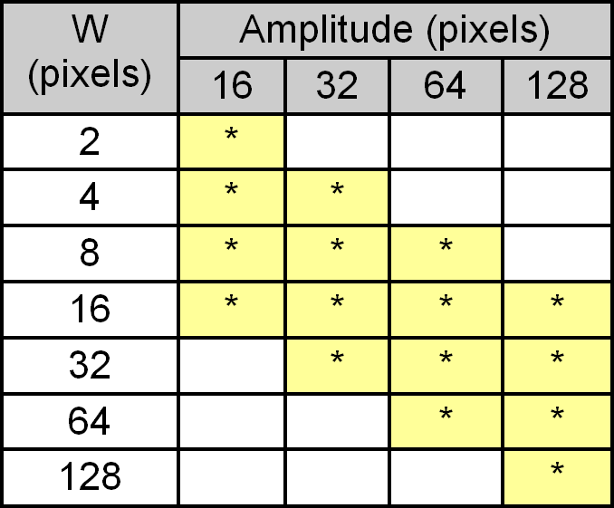
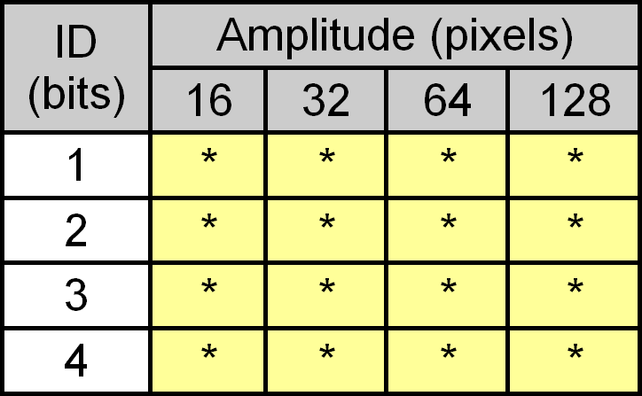
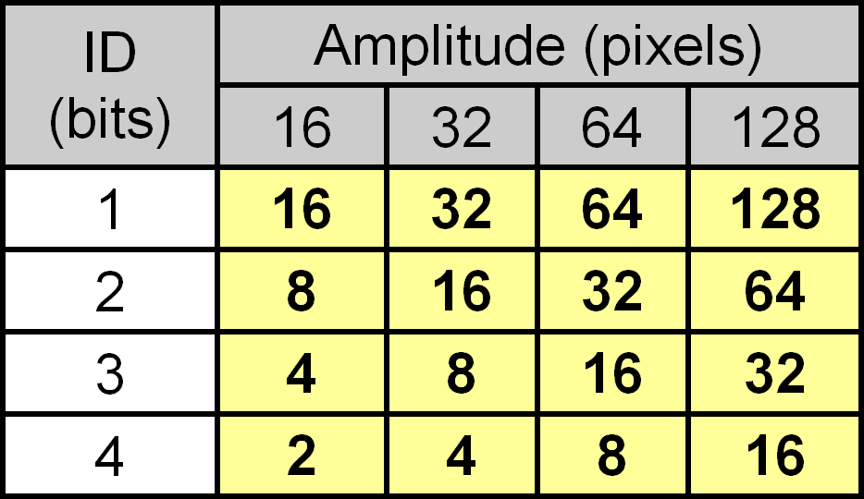
Fitts’ Law Example
Independent variables:
  Index of difficulty (ID): 1, 2, 3, 4 bits
  Amplitude: 16, 32, 64, 128 pixels
Note: ID = log₂(2A / W)
W is a confounding variable (see below)
Experiment design
(ID x Amplitude)
Showing width (W)
Experiment design
(W x Amplitude)
(See HCI:ERP for further discussion)

Slide 22
Experiment Task
Recall the definition of an independent variable:
  a circumstance or characteristic that is manipulated in an experiment to elicit a change in a human response while interacting with a computer
The experiment task must “elicit a change”
Qualities of a good task: represent, discriminate
  Represent activities people do with the interface
    Improves external validity (but may compromise internal validity)
  Discriminate among the test conditions
    Increases likelihood of a statistically significant outcome (i.e., the sought-after “change” occurs)

Slide 23
Task Examples
Usually the task is self-evident (follows directly from the research idea)
Research idea → a new graphical method for entering equations in a spreadsheet
  Experiment task → insert an equation using (a) the graphical method and (b) the conventional method
Research idea → an auditory feedback technique for programming a GPS device
  Experiment task → program a destination location into a GPS device using (a) the auditory feedback method and (b) the conventional method

Slide 24
Knowledge-based Tasks
Most experiment tasks are performance-based or skill-based (e.g., inserting an equation, programming a destination location; see previous slide)
Sometimes the task is knowledge-based (e.g., “Use an Internet search interface to find the birth date of Albert Einstein.”)
In this case, participants become contaminated (in a sense) after the first run of task, since they have acquired the knowledge
Experimentally, this poses problems (beware!)
A creative approach is needed (e.g., for the other test condition, slightly change the task; “…of William Shakespeare”)

Slide 25
Procedure
The procedure encompasses everything that occurs with participants
The procedure includes the experiment task (obviously), but everything else as well…
  Arriving, welcoming
  Signing a consent form
  Instructions given to participants about the experiment task (next slide)
  Demonstration trials, practice trials
  Rest breaks
  Administering of a questionnaire or an interview

Slide 26
Instructions
Very important (best to prepare in advance; write out)
Often the goal in the experiment task is “to proceed as quickly and accurately as possible but at a pace that is comfortable”
Other instructions are fine, as per the goal of the experiment or the nature of the tasks, but…
Give the same instructions to all participants
If a participant asks for clarification, do not change the instructions in a way that may cause the participant to behave differently from the other participants

Slide 27
Participants
Researchers want experimental results to apply to people not actually tested – a population
Population examples:
  Computer-literate adults, teenagers, children, people with certain disabilities, left-handed people, engineers, musicians, etc.
For results to apply generally to a population, the participants used in the experiment must be…
  Members of the desired population
  Selected at random from the population
True random sampling is rarely done (consider the number and location of people in the population examples above)
Some form of convenience sampling is typical

Slide 28
How Many Participants?
Too few → experimental effects fail to achieve statistical significance
Too many → statistical significance for effects of no practical value
The correct number… (drum roll please)
  Use the same number of participants as used in similar research¹
¹ Martin, D. W. (2004). Doing psychology experiments (6th ed.). Pacific Grove, CA. Belmont, CA: Wadsworth.

Slide 29
Questionnaires
Questionnaires are used in most HCI experiments
Two purposes
  Collect information about the participants
    Demographics (gender, age, first language, handedness, visual acuity, etc.)
    Prior experience with interfaces or interaction techniques related to the research
  Solicit feedback, comments, impressions, suggestions, etc., about participants’ use of the experimental apparatus
Questionnaires, as an adjunct to experimental research, are usually brief

Slide 30




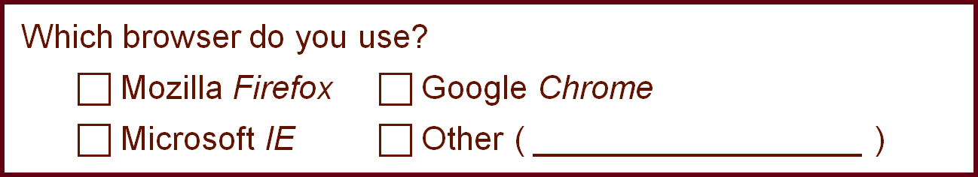

Information Questions
Questions constructed according to how the information will be used
Ratio-scale
data
Ordinal-scale
data
Open-ended
Closed

Slide 31
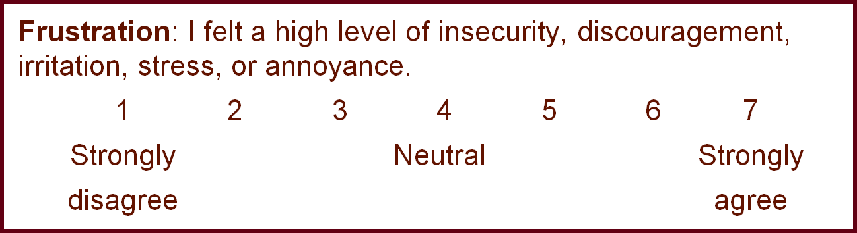
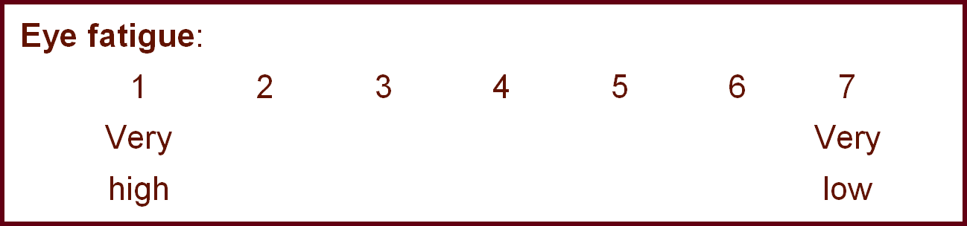
Participant Feedback
Using NASA Task Load Index (TLX):
ISO 9241-9:

Slide 32
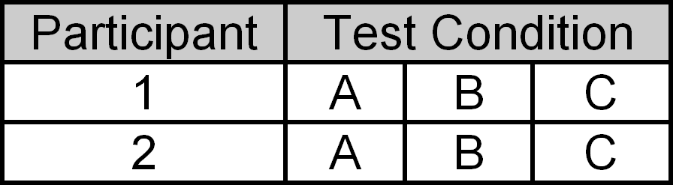
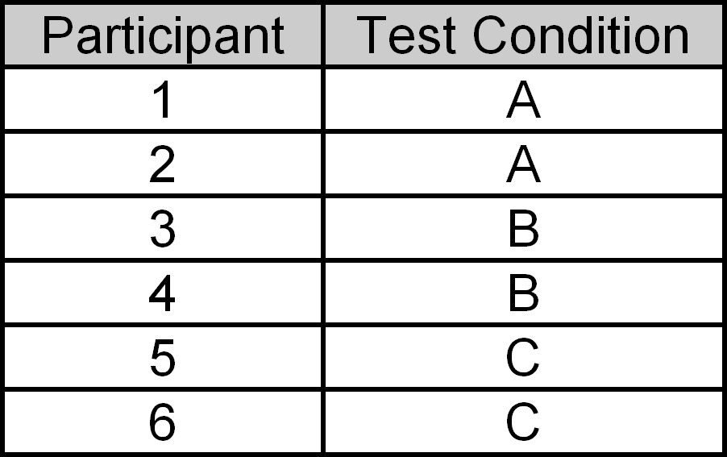
Within-subjects, Between-subjects
Two ways to assign conditions to participants:
  Within-subjects → each participant is tested on each condition
  Between-subjects → each participant is tested on one condition only
  Example: An IV with three test conditions (A, B, C):
Within-subjects
Between-subjects

Slide 33
Within-subjects, Between-subjects (2)
Within-subjects advantages
  Fewer participants (easier to recruit, schedule, etc.)
  Less “variation due to participants”
  No need to balance groups (because there is only one group!)
Within-subjects disadvantage
  Order effects (i.e., interference between conditions)
Between-subjects advantage
  No order effects (i.e., no interference between conditions)
Between-subjects disadvantage
  More participants (harder to recruit, schedule, etc.)
  More “variation due to participants”
  Need to balance groups (to ensure they are more or less the same)

Slide 34
Within-subjects, Between-subjects (3)
Sometimes…
  A factor must be assigned within-subjects
    Examples: Block, session (if learning is the IV)
  A factor must be assigned between-subjects
    Examples: gender, handedness
  There is a choice
    In this case, the balance tips to within-subjects (see previous slide)
With two factors, there are three possibilities:
    both factors within-subjects
    both factors between-subjects
    one factor within-subjects + one factor between-subjects (this is a mixed design)

Slide 35
Order Effects, Counterbalancing
Only relevant for within-subjects factors
The issue: order effects (aka learning effects, practice effects, fatigue effects, sequence effects)
Order effects offset by counterbalancing:
  Participants divided into groups
  Test conditions are administered in a different order to each group
  Order of administering test conditions uses a Latin square
  Distinguishing property of a Latin square → each condition occurs precisely once in each row and column (next slide)

Slide 36
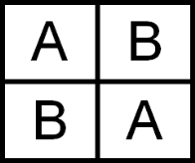
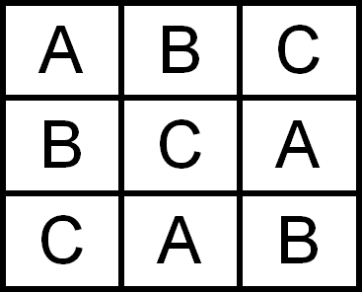
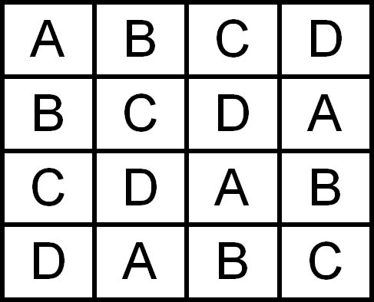
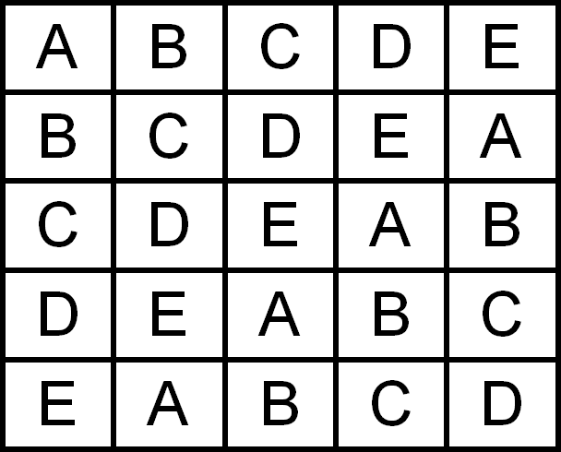
Latin Squares
2 x 2
3 x 3
4 x 4
5 x 5

Slide 37
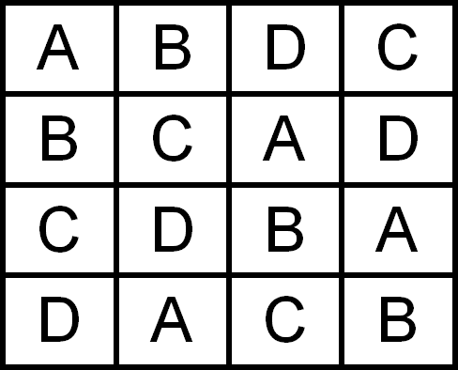
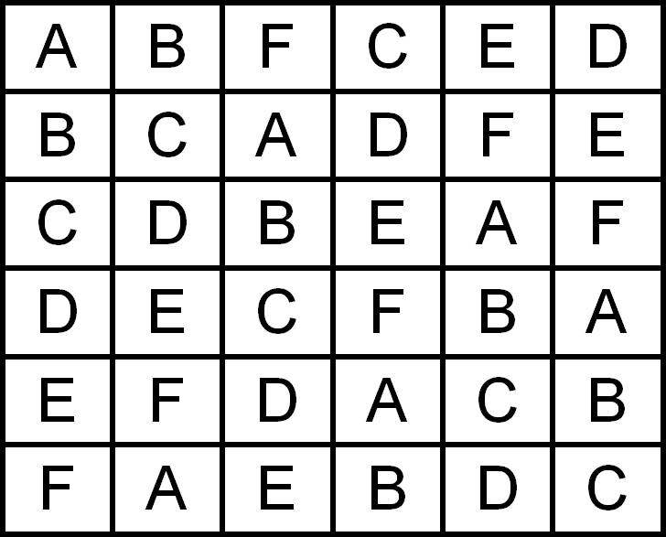
Balanced Latin Square
With a balanced Latin square, each condition precedes and follows each other condition an equal number of times
Only possible for even-orders
Top row pattern: A, B, n, C, n – 1, D, n – 2, …
4 x 4
6 x 6

Slide 38
Example
An experimenter seeks to determine if three editing methods (A, B, C) differ in the amount of time to do a common editing task:
Conditions are assigned within-subjects
Twelve participants are recruited and divided into three groups (4 participants/group)
Methods administered using a 3 × 3 Latin Square (2 slides back)
Results (next slide)

Slide 39
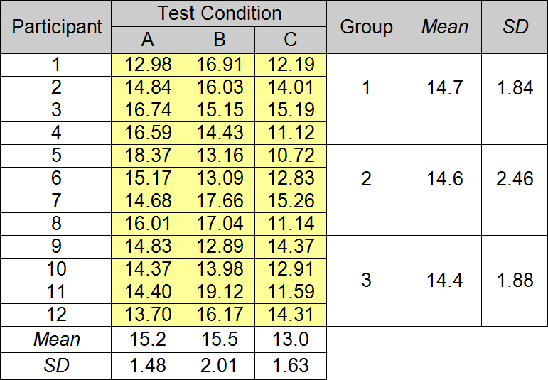

Results - Data
Group effect is small
∴ Counterbalancing worked!

Slide 40
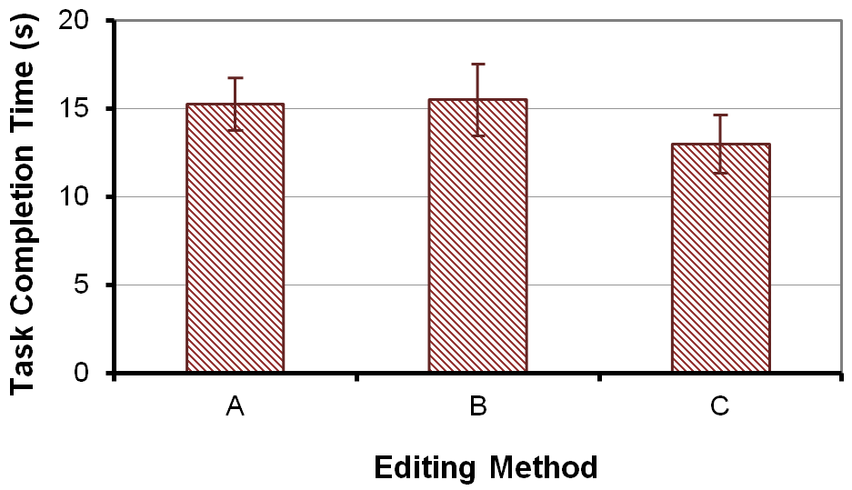
Results - Chart

Slide 41
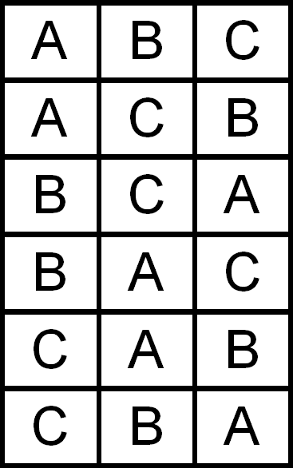


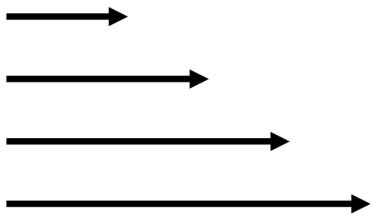
Other Techniques
Instead of using a Latin square,
all orders (n!) can be used; 3 × 3 case →
Conditions can be randomized
Randomizing best if the tasks are brief
and repeated often; examples (see below)
Target size
Movement direction
Movement distance

Slide 42
Asymmetric Skill Transfer
A phenomenon known as asymmetric skill transfer sometimes occurs in within-subjects designs
Figures in next three slides demonstrate
They are presented in the slides without an explanation (to be discussed in class)
Please see HCI:ERP for complete details and discussion (including how to avoid asymmetric skill transfer)

Slide 43
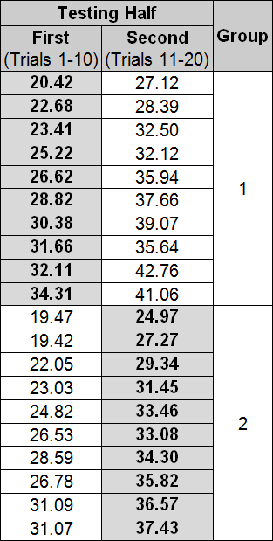
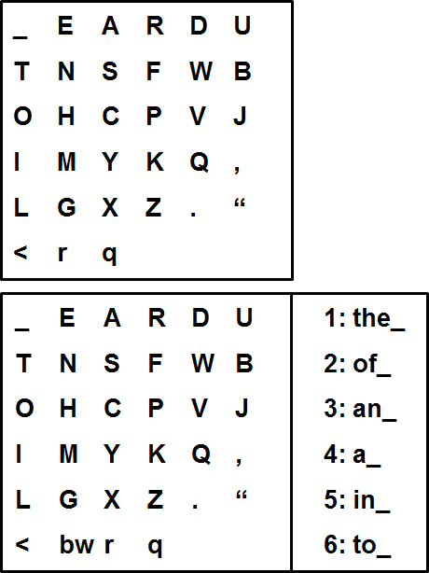

LO
Keyboard
L+WP
Keyboard
= LO

Slide 44
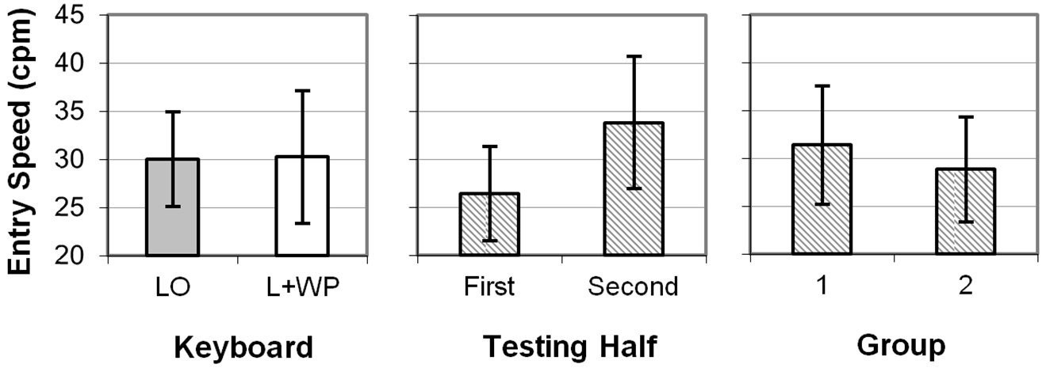

Slide 45
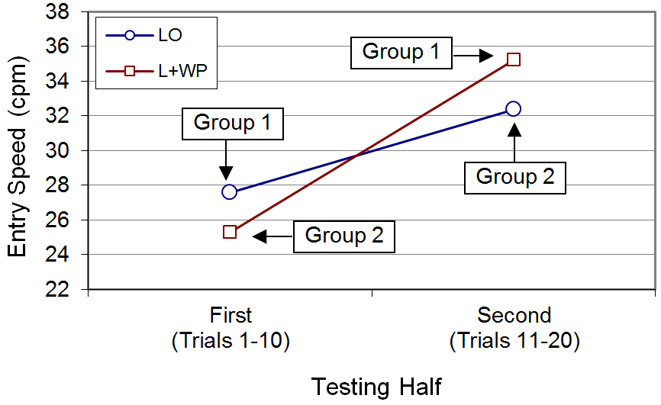

Slide 46
Longitudinal Studies
Sometimes instead of “balancing out” learning effects, the research seeks to promote and investigate learning
If so, a longitudinal study is conducted
“Practice” is the IV
Participants are practiced over a prolonged period of time
Practice units: blocks, sessions, hours, days, etc.
Example on next slide

Slide 47
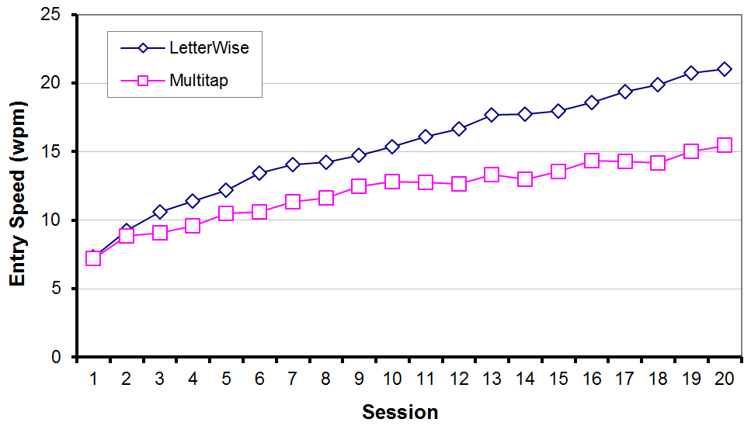
Longitudinal Study – Results¹
¹ MacKenzie, I. S., Kober, H., Smith, D., Jones, T., & Skepner, E. (2001). LetterWise: Prefix-based disambiguation for mobile text entry. Proceedings of the ACM Symposium on User Interface Software and Technology - UIST 2001, 111-120, New York: ACM.

Slide 48
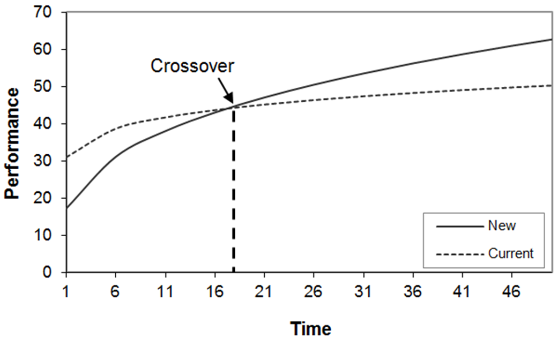
The New vs. The Old
Sometimes a new technique will initially perform poorly in comparison to an established technique
A longitudinal study will determine if a crossover point occurs and, if so, after how much practice (see below)

Slide 49
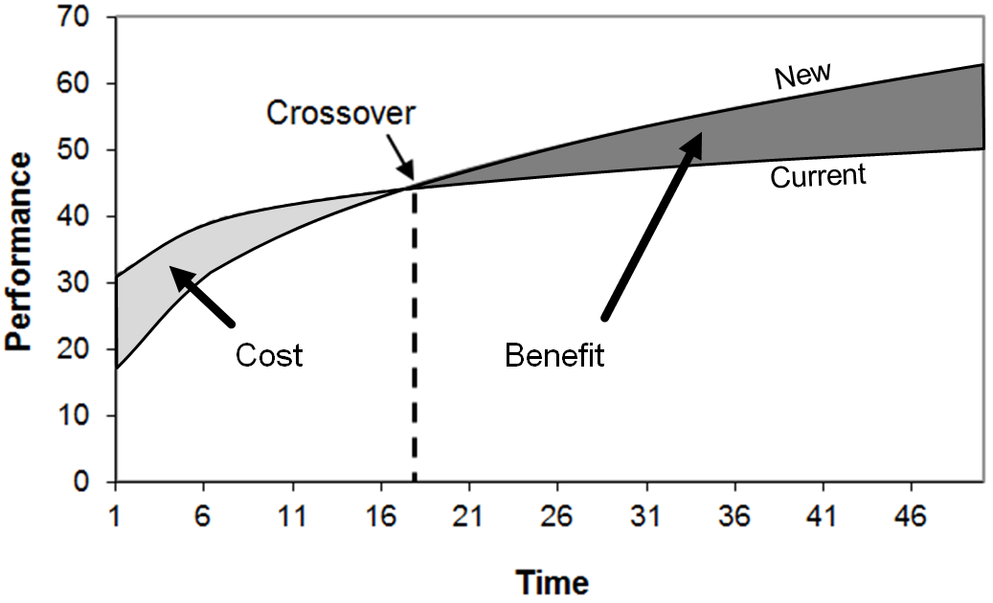
Cost-Benefit Trade-offs
New, improved techniques sometimes languish
Evidently, the benefit in the new technique is insufficient to overcome the cost in learning it (see below)
Of course, there are other issues (see HCI:ERP for discussion)

Slide 50
Empirical evaluation
Research questions (e.g. is new interface can be performed quickly than old?)
Type of experiment – (if compare new vs old) A/B style using think aloud
Tasks
No of participants and orders of user testing – between subject (how?), within subject (how?)
Data. And how to collect
Independent and dependent variables. Testing conditions
How to measure variables?
Procedures
Results analysis

Slide 51
Thank You

